Slide 1
Deep Learning
from A to Z
From the basics of Machine Learning to understanding TensorFlow internals
with Raphael Gontijo Lopes

Slide 2
Agenda
Machine Learning
Neural Networks
Neural Network Abstractions
TensorFlow
Practical Advice

Slide 3
Part 1: Machine Learning

Slide 4


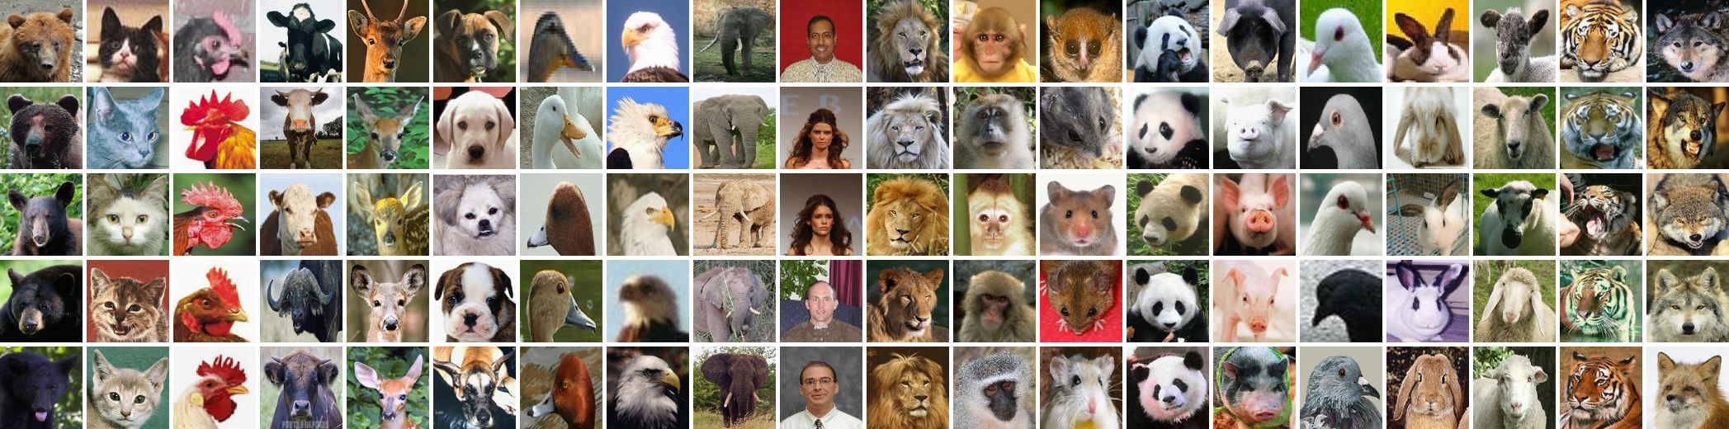
Data all around us
Notes:
Data produced by us
Biomedical data
Big datasets

Slide 5


Data has High-Level Features
ears
leaves
nose
sky
eyes
trunk
These are usually called ground-truth labels
And these features can be extracted from the data itself
Just think about what your brain is doing when you look at these pictures:
puppies
pandas
Notes:
Assumption is:
Data has high-level features (some higher level than others)
Can be extracted from data itself
Brain extracts “dog” from dog pic, but not from panda pic
These features are called labels

Slide 6
The problem we’re trying to solve
We want a classifier / predictor that can extract these high-level features from data
y = f(x)
label = f(example in dataset)
Solve for f
x
y
f
How do we solve for f?
Notes:
Want classifier that predicts labels from data
Function that converts data into labels
Won’t define F right now, Treat as black box for now.
How to solve for f?

Slide 7

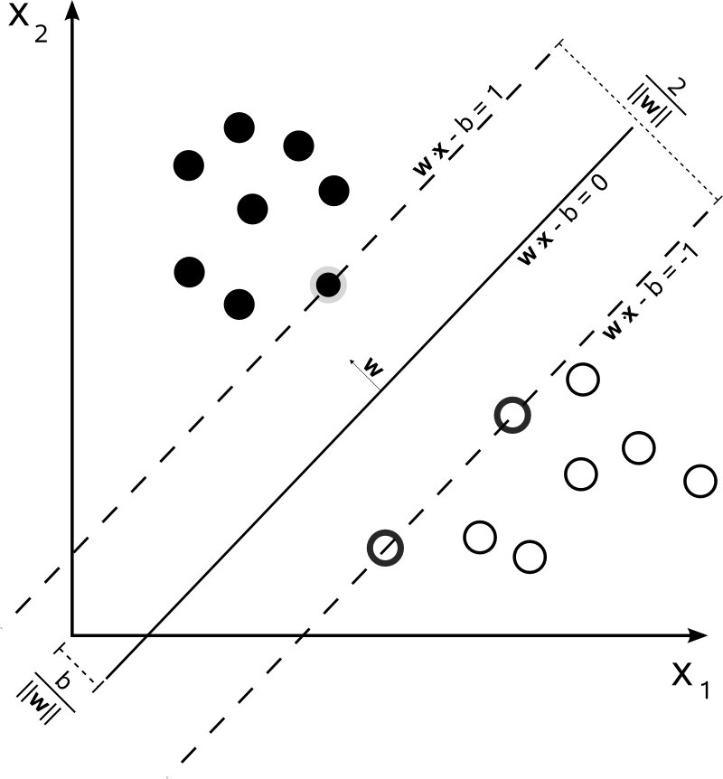
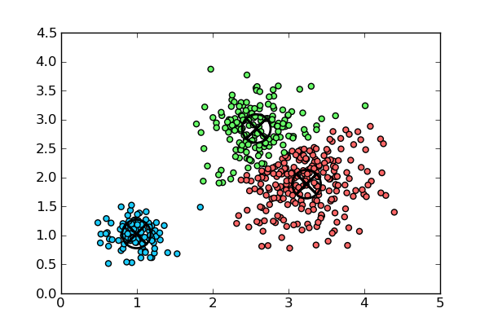
Machine Learning
ML is how we make computers learn these functions automatically
vs writing down explicit rules to manipulate the data
Some examples of classifiers:
decision trees
SVMs
K-means clustering
Today, we’ll talk about supervised learning
Others: unsupervised learning, reinforcement learning
Notes:
ML is how we teach computers to learn these functions automatically
Some examples of black boxes
Today: supervised (we have labeled data)

Slide 8
Machine Learning
Data has high-level features
Some of those features are called labels
You can extract those features and labels from data using classifiers
Machine Learning is how computers learn to do this (train classifiers)
Supervised Learning is ML where you learn from labeled data

Slide 9
Part 2: Neural Networks

Slide 10
Labels depend on data
Think of a data point as a vector of attributes
sq ft
rent
#bath
#bed
floor
[1200, 3500, 2, 2, 20]
NYC
apartments
Our label(s) will be conditioned on these
X (input)
H (features)
1200
3500
2
2
20
is NYC?
Is SFO?
...
Notes:
What do we know about our data?
Bunch of pieces of information (attributes)
Our labels are a function of these attributes.
“is NYC” is a function of all attributes, so is “is SFO”

Slide 11
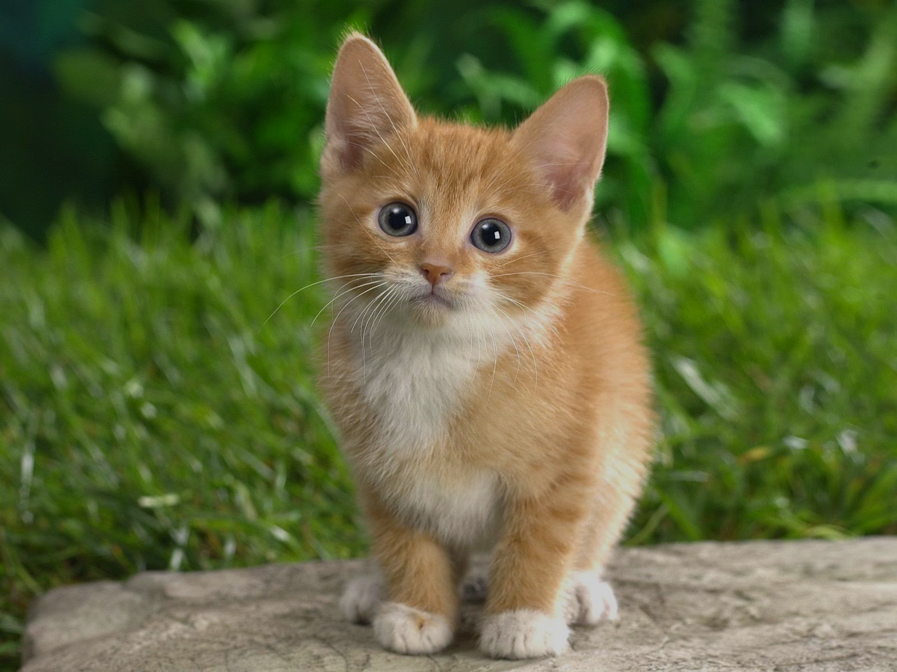
Labels depend on attributes in different amounts
Each label will depend on each of the attributes differently based on relevance
has cat in center of pic
is NYC? Is SFO?
h
x
ZIP
Code
Owner’s Eye Color
So we can assign weights to connections between attributes and labels
Often we won’t know what attributes are relevant
So we’d like an automatic way of doing this
Notes:
Also know each label depends on each attribute in different amounts
ZIP code is relevant for determining a city. Eye color isn’t
A label that described whether the cat is centered
will be more dependent on the pixels (attr) in the center of the pic
We can assign weights.
Dont know what attr are relevant
want automatic way (we’ll get to it)
Before, we need a way to compute labels
the computation that happens at those top nodes

Slide 12
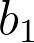

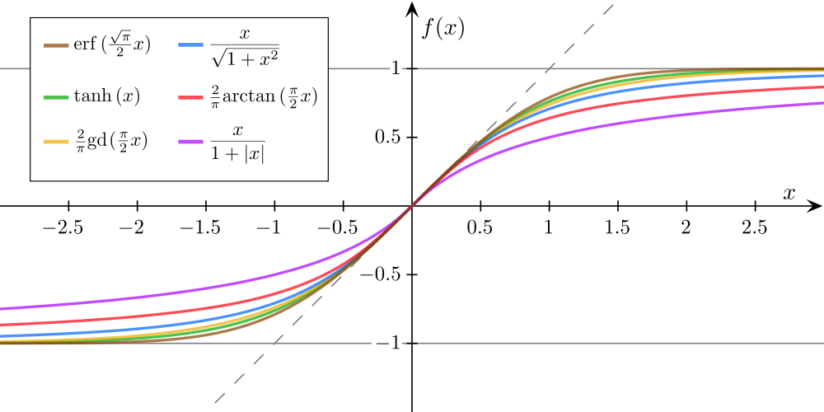
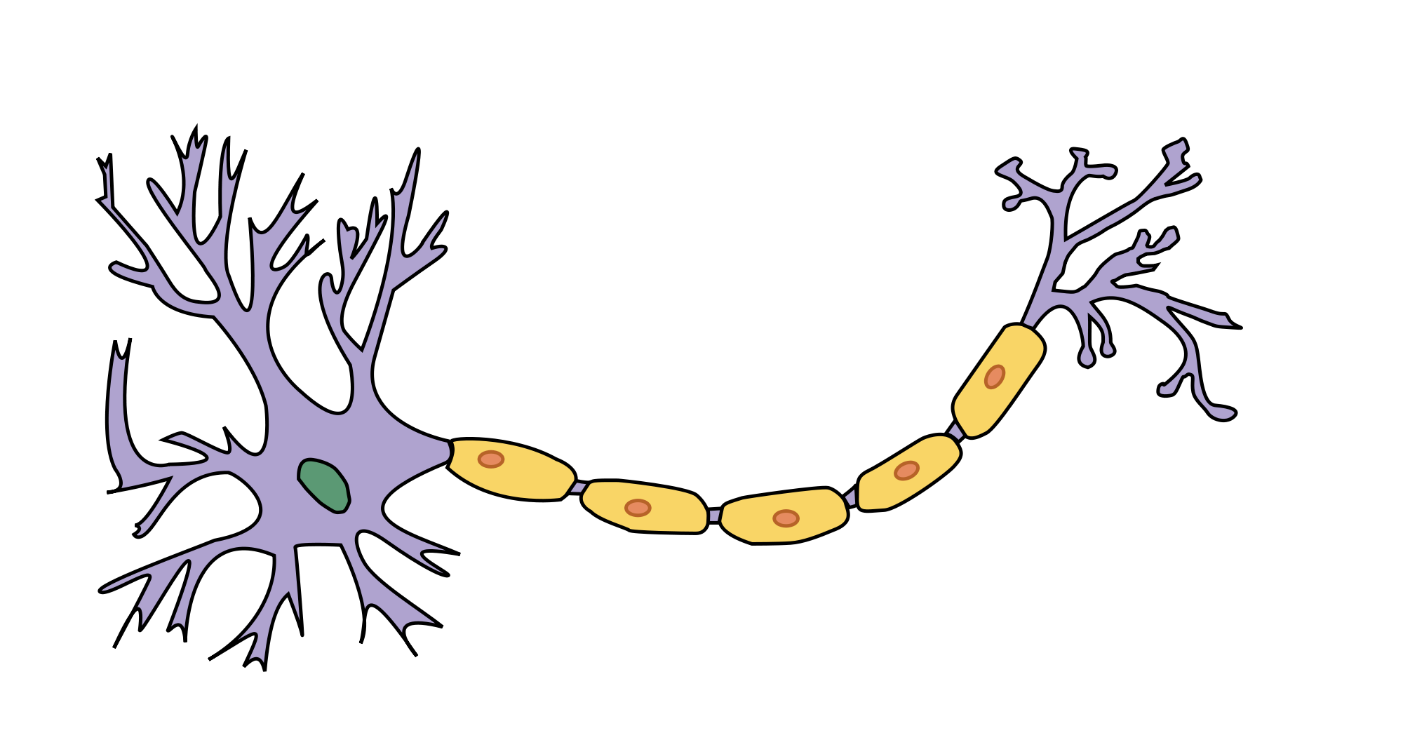
Label Computation
If we had the correct weights, how do we compute the labels?
Perceptron:
bias
1
non-linearity
h
Why use an activation function?
Probability background
Inspiration from neuroscience
Representation capabilities
Notes:
If we had correct weight, how to compute labels
Use perceptron:
it sums the weighted inputs (plus bias)
then applies a non-linearity/activation function
What is non linearity?
Why activation function? (prob, neuro, increased representation capabilities)

Slide 13
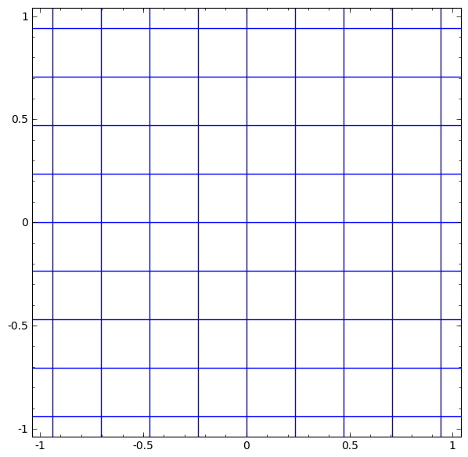
What kinds of functions can a Perceptron model?
Linear transformation
Translation
Non-linear transformation
These are the ingredients to approximate any function
bias
1
non-linearity
h
Notes:
You may ask: what kinds of functions can this represent:
In input space
Weighted sum of inputs is a linear transformation
Bias add is a translation
Activation function is a non-linear transformation

Slide 14
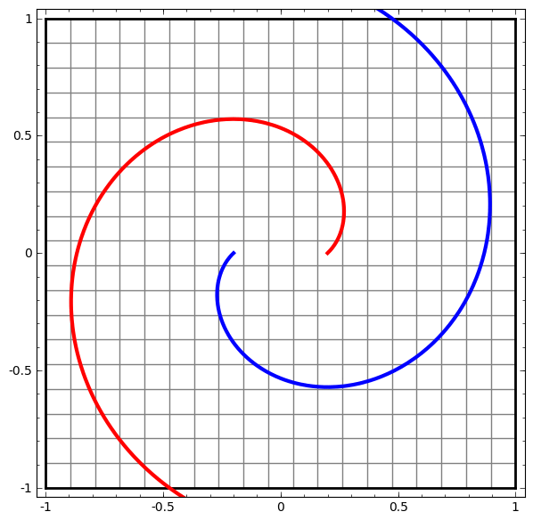
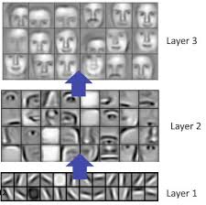
Deep Learning
Stack layers of perceptrons, each depending on the output of the layer before it.
input
...
labels
Allows us to represent any arbitrary function
Deeper = higher level features
Notes:
You can stack layers. Each layer depends on all the outputs of the previous layer
Many transformations of the input space
Allows us to represent any arbitrary function
Also creates a hierarchy of features.
Deeper layers, higher-level feature the network can learn
See image

Slide 15
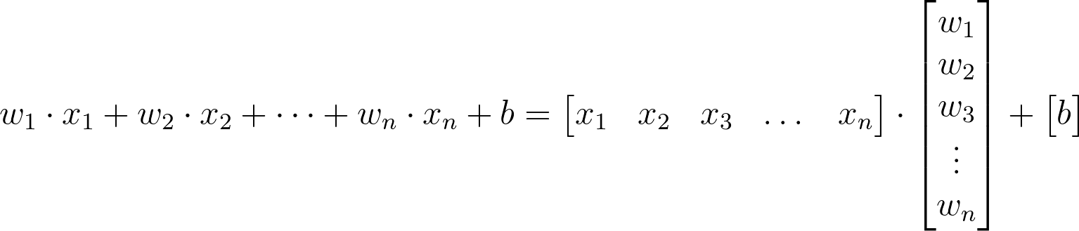
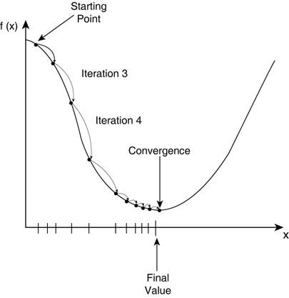
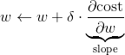
Gradient Descent
Now, how do we find the weights?
Minimize loss function based on gradient
sigm( )
= h
1
cost:
(true - h)²
h
For many weights, just compute derivative of loss wrt to each weight
Notes:
We have our black box!
Now, the problem of machine learning is that of finding good weights for your data/labels
If you can compute a loss function
(which you can since you have truth labels)
Then you can minimize that loss by tweaking weights based on their gradient (derivative)
Start with random weights
Works for multiple weights too

Slide 16
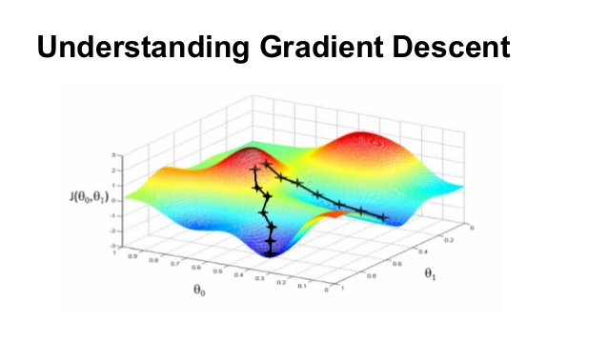
Backpropagation
Propagation of errors/loss back through the layers
1
1
h
h
input
...
labels
truth labels
cost
(optimization objective)
something we’re
trying to optimize
feed-forward
backpropagation of errors
weights we
can modify
Notes:
When you have multiple layers, you just propagate errors back
by applying chain rule
Don’t worry too much about details here,
What you need to take away is:
to find the weights, we need a loss function we can minimize

Slide 17
Neural Networks
Data is composed of attributes
Labels can be extracted from those attributes
Some attributes are more relevant for determining a label (so we weight it higher)
Perceptrons uses those weights to compute higher-level features
Layers of perceptrons can approximate any kind of function (including extracting labels from data) and even higher level features that themselves depend on high level features
We find optimal weights using Gradient Descent
(modifying all weights using derivative of a loss function)

Slide 18
Part 3: NN Abstractions

Slide 19
How to represent a Neural Network in code?
“class Perceptron(object):” no!
Vectorization:
1
h
Notes:
You might be tempted to implement a perceptron class
But it’s very inefficient, since NNs can have hundreds of layers and millions of neurons
Instead we use a trick called vectorization
You can represent an entire perceptron’s operation with a matrix multiplication

Slide 20
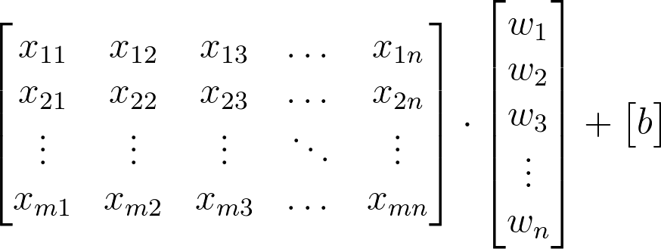
Batch of examples
Notes:
You want to train on mutiple examples at once
still one matrix multiplication

Slide 21
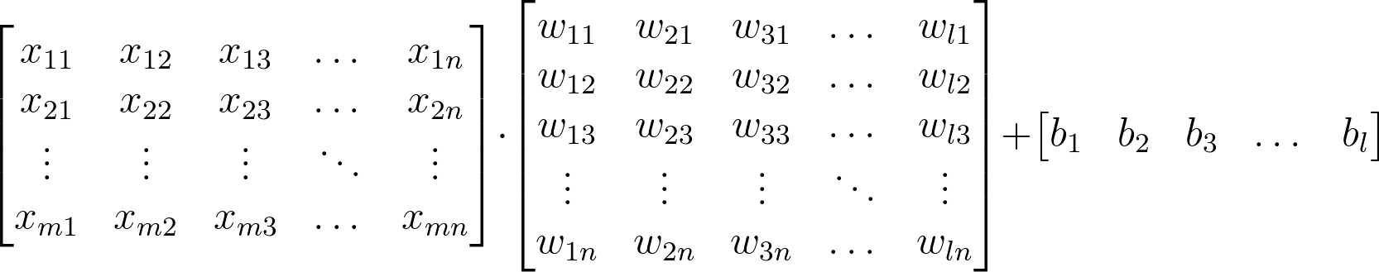
Whole layer + batch of examples
Neural Network = series of matrix multiplications
Reason why GPUs are great for ML
Notes:
One entire layer of a neural network in a single matrix multiply
So NNs can be thought of as a series of subsequent matrix multiplications
It’s why GPUs are good for machine learning: they have matmul optimized

Slide 22
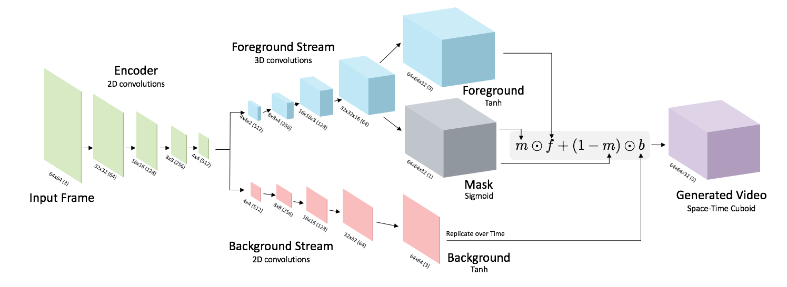
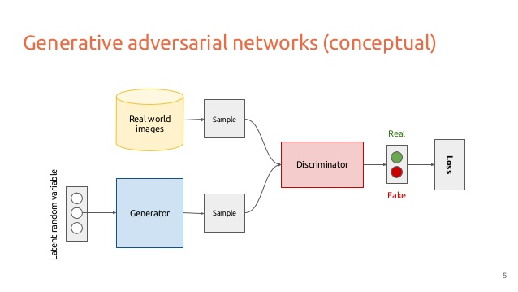
Representing an entire neural network
Now you might want to hold a stack of matrices, and call it a Neural Network
Issue: Weird models that branch, concatenate vectors, recurse, etc.
Notes:
You might want to keep track of all layers with a stack or a list
But models can do weird things, like branching, concating, etc

Slide 23
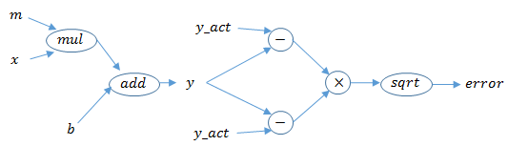
Computational Graphs
Each node defines an operation, and how to compute its derivative
Chain Rule:
d loss = d loss * d mul
d m d mul d m
Optimization:
Toposort nodes
Feed forward
Backprop updating nodes along the way
Notes:
You hold matrices of your inputs and weights
And define operation as nodes in your graph
Each node knows how backpropagation through it works
Optimizing loss is a matter of toposorting, feedforward, and backproping through nodes, updating weights along the way
but this is handled for us by tensorflow

Slide 24
NN Abstractions
Whole layers of Neural Networks can be expressed with a matrix multiplication
GPUs are very fast for multiplying matrices
Whole Neural Networks can be represented by a computational graph, which perform operations over those matrices (or tensors)

Slide 25
Part 4: TensorFlow

Slide 26
A library for creating computation graphs
You define nodes and operations in python
TensorFlow builds the computation graph under the hood
When you have your model, just give tensorflow some data
It will run it through the graph and optimize your loss function
tf.Variable
tf.placeholder
tf.matmul
tf.Variable
tf.add
Notes:
Lib for computation graphs
Define ops in python, tf build CG under the hood
Give it some data, it runs it through the graph

Slide 27
Placeholders
import tensorflow as tf
x = tf.placeholder(tf.float32, [None, 784])
y_truth = tf.placeholder(tf.float32, [None, 10])
# First Layer
W1 = tf.Variable(tf.truncated_normal([784, 20]))
b1 = tf.Variable(tf.truncated_normal([20]))
z = tf.matmul(x, W1) + b1
h = tf.nn.sigmoid(z)
# Second layer
W2 = tf.Variable(tf.truncated_normal([20, 10]))
b2 = tf.Variable(tf.truncated_normal([10]))
y = tf.matmul(h, W2) + b2
# Define loss and optimizer
cross_entropy_loss = tf.reduce_mean(
tf.nn.softmax_cross_entropy_with_logits(labels=y_truth, logits=y))
train_step = tf.train.GradientDescentOptimizer(0.5).minimize(cross_entropy_loss)
y_t
x

Slide 28
dTypes, shapes
import tensorflow as tf
x = tf.placeholder(tf.float32, [None, 784])
y_truth = tf.placeholder(tf.float32, [None, 10])
# First Layer
W1 = tf.Variable(tf.truncated_normal([784, 20]))
b1 = tf.Variable(tf.truncated_normal([20]))
z = tf.matmul(x, W1) + b1
h = tf.nn.sigmoid(z)
# Second layer
W2 = tf.Variable(tf.truncated_normal([20, 10]))
b2 = tf.Variable(tf.truncated_normal([10]))
y = tf.matmul(h, W2) + b2
# Define loss and optimizer
cross_entropy_loss = tf.reduce_mean(
tf.nn.softmax_cross_entropy_with_logits(labels=y_truth, logits=y))
train_step = tf.train.GradientDescentOptimizer(0.5).minimize(cross_entropy_loss)
y_t
x

Slide 29
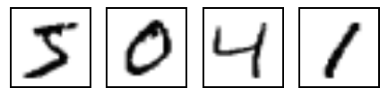
mnist
import tensorflow as tf
x = tf.placeholder(tf.float32, [None, 784])
y_truth = tf.placeholder(tf.float32, [None, 10])
# First Layer
W1 = tf.Variable(tf.truncated_normal([784, 20]))
b1 = tf.Variable(tf.truncated_normal([20]))
z = tf.matmul(x, W1) + b1
h = tf.nn.sigmoid(z)
# Second layer
W2 = tf.Variable(tf.truncated_normal([20, 10]))
b2 = tf.Variable(tf.truncated_normal([10]))
y = tf.matmul(h, W2) + b2
# Define loss and optimizer
cross_entropy_loss = tf.reduce_mean(
tf.nn.softmax_cross_entropy_with_logits(labels=y_truth, logits=y))
train_step = tf.train.GradientDescentOptimizer(0.5).minimize(cross_entropy_loss)
y_t
x

Slide 30
Variables
import tensorflow as tf
x = tf.placeholder(tf.float32, [None, 784])
y_truth = tf.placeholder(tf.float32, [None, 10])
# First Layer
W1 = tf.Variable(tf.truncated_normal([784, 20]))
b1 = tf.Variable(tf.truncated_normal([20]))
z = tf.matmul(x, W1) + b1
h = tf.nn.sigmoid(z)
# Second layer
W2 = tf.Variable(tf.truncated_normal([20, 10]))
b2 = tf.Variable(tf.truncated_normal([10]))
y = tf.matmul(h, W2) + b2
# Define loss and optimizer
cross_entropy_loss = tf.reduce_mean(
tf.nn.softmax_cross_entropy_with_logits(labels=y_truth, logits=y))
train_step = tf.train.GradientDescentOptimizer(0.5).minimize(cross_entropy_loss)
y_t
b1
x
w1

Slide 31
Initializers
import tensorflow as tf
x = tf.placeholder(tf.float32, [None, 784])
y_truth = tf.placeholder(tf.float32, [None, 10])
# First Layer
W1 = tf.Variable(tf.truncated_normal([784, 20]))
b1 = tf.Variable(tf.truncated_normal([20]))
z = tf.matmul(x, W1) + b1
h = tf.nn.sigmoid(z)
# Second layer
W2 = tf.Variable(tf.truncated_normal([20, 10]))
b2 = tf.Variable(tf.truncated_normal([10]))
y = tf.matmul(h, W2) + b2
# Define loss and optimizer
cross_entropy_loss = tf.reduce_mean(
tf.nn.softmax_cross_entropy_with_logits(labels=y_truth, logits=y))
train_step = tf.train.GradientDescentOptimizer(0.5).minimize(cross_entropy_loss)
y_t
b1
nrm
x
w1
nrm

Slide 32
Math operations
import tensorflow as tf
x = tf.placeholder(tf.float32, [None, 784])
y_truth = tf.placeholder(tf.float32, [None, 10])
# First Layer
W1 = tf.Variable(tf.truncated_normal([784, 20]))
b1 = tf.Variable(tf.truncated_normal([20]))
z = tf.matmul(x, W1) + b1
h = tf.nn.sigmoid(z)
# Second layer
W2 = tf.Variable(tf.truncated_normal([20, 10]))
b2 = tf.Variable(tf.truncated_normal([10]))
y = tf.matmul(h, W2) + b2
# Define loss and optimizer
cross_entropy_loss = tf.reduce_mean(
tf.nn.softmax_cross_entropy_with_logits(labels=y_truth, logits=y))
train_step = tf.train.GradientDescentOptimizer(0.5).minimize(cross_entropy_loss)
y_t
+
*
b1
nrm
x
w1
nrm

Slide 33
Activation functions
import tensorflow as tf
x = tf.placeholder(tf.float32, [None, 784])
y_truth = tf.placeholder(tf.float32, [None, 10])
# First Layer
W1 = tf.Variable(tf.truncated_normal([784, 20]))
b1 = tf.Variable(tf.truncated_normal([20]))
z = tf.matmul(x, W1) + b1
h = tf.nn.sigmoid(z)
# Second layer
W2 = tf.Variable(tf.truncated_normal([20, 10]))
b2 = tf.Variable(tf.truncated_normal([10]))
y = tf.matmul(h, W2) + b2
# Define loss and optimizer
cross_entropy_loss = tf.reduce_mean(
tf.nn.softmax_cross_entropy_with_logits(labels=y_truth, logits=y))
train_step = tf.train.GradientDescentOptimizer(0.5).minimize(cross_entropy_loss)
y_t
sig
+
*
b1
nrm
x
w1
nrm

Slide 34
Layer 2
import tensorflow as tf
x = tf.placeholder(tf.float32, [None, 784])
y_truth = tf.placeholder(tf.float32, [None, 10])
# First Layer
W1 = tf.Variable(tf.truncated_normal([784, 20]))
b1 = tf.Variable(tf.truncated_normal([20]))
z = tf.matmul(x, W1) + b1
h = tf.nn.sigmoid(z)
# Second layer
W2 = tf.Variable(tf.truncated_normal([20, 10]))
b2 = tf.Variable(tf.truncated_normal([10]))
y = tf.matmul(h, W2) + b2
# Define loss and optimizer
cross_entropy_loss = tf.reduce_mean(
tf.nn.softmax_cross_entropy_with_logits(labels=y_truth, logits=y))
train_step = tf.train.GradientDescentOptimizer(0.5).minimize(cross_entropy_loss)
y_t
+
*
b2
nrm
sig
w2
nrm
+
*
b1
nrm
x
w1
nrm

Slide 35
Note how we’re building on top of last layer
import tensorflow as tf
x = tf.placeholder(tf.float32, [None, 784])
y_truth = tf.placeholder(tf.float32, [None, 10])
# First Layer
W1 = tf.Variable(tf.truncated_normal([784, 20]))
b1 = tf.Variable(tf.truncated_normal([20]))
z = tf.matmul(x, W1) + b1
h = tf.nn.sigmoid(z)
# Second layer
W2 = tf.Variable(tf.truncated_normal([20, 10]))
b2 = tf.Variable(tf.truncated_normal([10]))
y = tf.matmul(h, W2) + b2
# Define loss and optimizer
cross_entropy_loss = tf.reduce_mean(
tf.nn.softmax_cross_entropy_with_logits(labels=y_truth, logits=y))
train_step = tf.train.GradientDescentOptimizer(0.5).minimize(cross_entropy_loss)
y_t
+
*
b2
nrm
sig
w2
nrm
+
*
b1
nrm
x
w1
nrm

Slide 36
Defining cross entropy loss
import tensorflow as tf
x = tf.placeholder(tf.float32, [None, 784])
y_truth = tf.placeholder(tf.float32, [None, 10])
# First Layer
W1 = tf.Variable(tf.truncated_normal([784, 20]))
b1 = tf.Variable(tf.truncated_normal([20]))
z = tf.matmul(x, W1) + b1
h = tf.nn.sigmoid(z)
# Second layer
W2 = tf.Variable(tf.truncated_normal([20, 10]))
b2 = tf.Variable(tf.truncated_normal([10]))
y = tf.matmul(h, W2) + b2
# Define loss and optimizer
cross_entropy_loss = tf.reduce_mean(
tf.nn.softmax_cross_entropy_with_logits(labels=y_truth, logits=y))
train_step = tf.train.GradientDescentOptimizer(0.5).minimize(cross_entropy_loss)
y_t
cel
sfm
+
*
b2
nrm
sig
w2
nrm
+
*
b1
nrm
x
w1
nrm

Slide 37
Get mean cross entropy across examples
import tensorflow as tf
x = tf.placeholder(tf.float32, [None, 784])
y_truth = tf.placeholder(tf.float32, [None, 10])
# First Layer
W1 = tf.Variable(tf.truncated_normal([784, 20]))
b1 = tf.Variable(tf.truncated_normal([20]))
z = tf.matmul(x, W1) + b1
h = tf.nn.sigmoid(z)
# Second layer
W2 = tf.Variable(tf.truncated_normal([20, 10]))
b2 = tf.Variable(tf.truncated_normal([10]))
y = tf.matmul(h, W2) + b2
# Define loss and optimizer
cross_entropy_loss = tf.reduce_mean(
tf.nn.softmax_cross_entropy_with_logits(labels=y_truth, logits=y))
train_step = tf.train.GradientDescentOptimizer(0.5).minimize(cross_entropy_loss)
y_t
cel
r m
sfm
+
*
b2
nrm
sig
w2
nrm
+
*
b1
nrm
x
w1
nrm

Slide 38
Optimizer
import tensorflow as tf
x = tf.placeholder(tf.float32, [None, 784])
y_truth = tf.placeholder(tf.float32, [None, 10])
# First Layer
W1 = tf.Variable(tf.truncated_normal([784, 20]))
b1 = tf.Variable(tf.truncated_normal([20]))
z = tf.matmul(x, W1) + b1
h = tf.nn.sigmoid(z)
# Second layer
W2 = tf.Variable(tf.truncated_normal([20, 10]))
b2 = tf.Variable(tf.truncated_normal([10]))
y = tf.matmul(h, W2) + b2
# Define loss and optimizer
cross_entropy_loss = tf.reduce_mean(
tf.nn.softmax_cross_entropy_with_logits(labels=y_truth, logits=y))
train_step = tf.train.GradientDescentOptimizer(0.5).minimize(cross_entropy_loss)
y_t
cel
r m
GD
sfm
+
*
b2
nrm
sig
w2
nrm
+
*
b1
nrm
x
w1
nrm

Slide 39
Optimizer
import tensorflow as tf
x = tf.placeholder(tf.float32, [None, 784])
y_truth = tf.placeholder(tf.float32, [None, 10])
# First Layer
W1 = tf.Variable(tf.truncated_normal([784, 20]))
b1 = tf.Variable(tf.truncated_normal([20]))
z = tf.matmul(x, W1) + b1
h = tf.nn.sigmoid(z)
# Second layer
W2 = tf.Variable(tf.truncated_normal([20, 10]))
b2 = tf.Variable(tf.truncated_normal([10]))
y = tf.matmul(h, W2) + b2
# Define loss and optimizer
cross_entropy_loss = tf.reduce_mean(
tf.nn.softmax_cross_entropy_with_logits(labels=y_truth, logits=y))
train_step = tf.train.GradientDescentOptimizer(0.5).minimize(cross_entropy_loss)
y_t
cel
r m
GD
sfm
+
*
b2
nrm
sig
w2
nrm
+
*
b1
nrm
x
w1
nrm

Slide 40
Start session (interface with underlying graph)
# Start session
sess = tf.Session()
sess.run(tf.global_variables_initializer())
# Train
for _ in range(5000):
batch_xs, batch_ys = mnist.train.next_batch(100)
sess.run(train_step, feed_dict={x: batch_xs, y_truth: batch_ys})
# Test trained model
correct_prediction = tf.equal(tf.argmax(y, 1), tf.argmax(y_truth, 1))
accuracy = tf.reduce_mean(tf.cast(correct_prediction, tf.float32))
print(sess.run(accuracy, feed_dict={x: mnist.test.images,
y_truth: mnist.test.labels}))
GD
y_t
r m
cel
sfm
+
*
b2
nrm
sig
w2
nrm
+
*
b1
nrm
python
x
w1
nrm

Slide 41
Training steps
# Start session
sess = tf.Session()
sess.run(tf.global_variables_initializer())
# Train
for _ in range(5000):
batch_xs, batch_ys = mnist.train.next_batch(100)
sess.run(train_step, feed_dict={x: batch_xs, y_truth: batch_ys})
# Test trained model
correct_prediction = tf.equal(tf.argmax(y, 1), tf.argmax(y_truth, 1))
accuracy = tf.reduce_mean(tf.cast(correct_prediction, tf.float32))
print(sess.run(accuracy, feed_dict={x: mnist.test.images,
y_truth: mnist.test.labels}))
GD
y_t
r m
cel
sfm
+
*
b2
nrm
sig
w2
nrm
+
*
b1
nrm
python
x
w1
nrm

Slide 42
Get mini batch of examples
# Start session
sess = tf.Session()
sess.run(tf.global_variables_initializer())
# Train
for _ in range(5000):
batch_xs, batch_ys = mnist.train.next_batch(100)
sess.run(train_step, feed_dict={x: batch_xs, y_truth: batch_ys})
# Test trained model
correct_prediction = tf.equal(tf.argmax(y, 1), tf.argmax(y_truth, 1))
accuracy = tf.reduce_mean(tf.cast(correct_prediction, tf.float32))
print(sess.run(accuracy, feed_dict={x: mnist.test.images,
y_truth: mnist.test.labels}))
GD
y_t
r m
cel
sfm
+
*
b2
nrm
sig
w2
nrm
+
dataset
batch
*
b1
nrm
python
x
w1
nrm

Slide 43
Run train_step operation, feeding examples to placeholders
# Start session
sess = tf.Session()
sess.run(tf.global_variables_initializer())
# Train
for _ in range(5000):
batch_xs, batch_ys = mnist.train.next_batch(100)
sess.run(train_step, feed_dict={x: batch_xs, y_truth: batch_ys})
# Test trained model
correct_prediction = tf.equal(tf.argmax(y, 1), tf.argmax(y_truth, 1))
accuracy = tf.reduce_mean(tf.cast(correct_prediction, tf.float32))
print(sess.run(accuracy, feed_dict={x: mnist.test.images,
y_truth: mnist.test.labels}))
GD
y_t
r m
cel
sfm
+
*
b2
nrm
sig
w2
nrm
+
*
b1
nrm
python
x
w1
nrm

Slide 44
Run train_step operation, feeding examples to placeholders
# Start session
sess = tf.Session()
sess.run(tf.global_variables_initializer())
# Train
for _ in range(5000):
batch_xs, batch_ys = mnist.train.next_batch(100)
sess.run(train_step, feed_dict={x: batch_xs, y_truth: batch_ys})
# Test trained model
correct_prediction = tf.equal(tf.argmax(y, 1), tf.argmax(y_truth, 1))
accuracy = tf.reduce_mean(tf.cast(correct_prediction, tf.float32))
print(sess.run(accuracy, feed_dict={x: mnist.test.images,
y_truth: mnist.test.labels}))
GD
y_t
r m
cel
sfm
+
*
b2
nrm
sig
w2
nrm
+
*
b1
nrm
python
python
x
w1
nrm

Slide 45
Test model after training (we’ll talk about this later)
# Start session
sess = tf.Session()
sess.run(tf.global_variables_initializer())
# Train
for _ in range(5000):
batch_xs, batch_ys = mnist.train.next_batch(100)
sess.run(train_step, feed_dict={x: batch_xs, y_truth: batch_ys})
# Test trained model
correct_prediction = tf.equal(tf.argmax(y, 1), tf.argmax(y_truth, 1))
accuracy = tf.reduce_mean(tf.cast(correct_prediction, tf.float32))
print(sess.run(accuracy, feed_dict={x: mnist.test.images,
y_truth: mnist.test.labels}))
GD
y_t
r m
cel
sfm
+
*
b2
nrm
sig
w2
nrm
+
*
b1
nrm
python
x
w1
nrm

Slide 46
Test model after training (we’ll talk about this later)
# Start session
sess = tf.Session()
sess.run(tf.global_vatiables_initializer())
# Train
for _ in range(5000):
batch_xs, batch_ys = mnist.train.next_batch(100)
sess.run(train_step, feed_dict={x: batch_xs, y_truth: batch_ys})
# Test trained model
correct_prediction = tf.equal(tf.argmax(y, 1), tf.argmax(y_truth, 1))
accuracy = tf.reduce_mean(tf.cast(correct_prediction, tf.float32))
print(sess.run(accuracy, feed_dict={x: mnist.test.images,
y_truth: mnist.test.labels}))
~92% accuracy
full source: https://github.com/iRapha/tensorflow-play/blob/master/easy_mnist.py

Slide 47
Advanced things: summaries
x = tf.placeholder(tf.float32, [None, 784], name=’x’)
…
tf.summary.histogram(‘W2’, W2)
tf.summary.scalar(‘cross_entropy_loss’, cross_entropy_loss)
…
summary_op = tf.merge_all_summaries()
summary_writer = tf.summary.FileWriter(FLAGS.train_dir, sess.graph)
…
for step in range(5000):
batch_xs, batch_ys = mnist.train.next_batch(100)
summary, _ = sess.run([summary_op, train_step],
feed_dict={x: batch_xs, y_truth: batch_ys})
summary_writer.add_summary(summary, step)
GD
r m
y_t
cel
sfm
+
nrm
b2
*
nrm
w2
sig

Slide 48
Advanced things: summaries
x = tf.placeholder(tf.float32, [None, 784], name=’x’)
…
tf.histogram_summary(‘W2’, W2)
tf.scalar_summary(‘cross_entropy_loss’, cross_entropy_loss)
…
summary_op = tf.merge_all_summaries()
summary_writer = tf.train.SummaryWriter(FLAGS.train_dir, sess.graph)
…
for step in range(5000):
batch_xs, batch_ys = mnist.train.next_batch(100)
summary, _ = sess.run([summary_op, train_step],
feed_dict={x: batch_xs, y_truth: batch_ys})
summary_writer.add_summary(summary, step)
GD
r m
smm
smm
y_t
cel
sfm
+
nrm
b2
*
nrm
w2
sig

Slide 49
Advanced things: summaries
x = tf.placeholder(tf.float32, [None, 784], name=’x’)
…
tf.histogram_summary(‘W2’, W2)
tf.scalar_summary(‘cross_entropy_loss’, cross_entropy_loss)
…
summary_op = tf.merge_all_summaries()
summary_writer = tf.train.SummaryWriter(FLAGS.train_dir, sess.graph)
…
for step in range(5000):
batch_xs, batch_ys = mnist.train.next_batch(100)
summary, _ = sess.run([summary_op, train_step],
feed_dict={x: batch_xs, y_truth: batch_ys})
summary_writer.add_summary(summary, step)
mrg
GD
r m
smm
smm
y_t
cel
sfm
+
nrm
b2
*
nrm
w2
sig

Slide 50
Advanced things: summaries
x = tf.placeholder(tf.float32, [None, 784], name=’x’)
…
tf.histogram_summary(‘W2’, W2)
tf.scalar_summary(‘cross_entropy_loss’, cross_entropy_loss)
…
summary_op = tf.merge_all_summaries()
summary_writer = tf.train.SummaryWriter(FLAGS.train_dir, sess.graph)
…
for step in range(5000):
batch_xs, batch_ys = mnist.train.next_batch(100)
summary, _ = sess.run([summary_op, train_step],
feed_dict={x: batch_xs, y_truth: batch_ys})
summary_writer.add_summary(summary, step)
python
[file.txt]
mrg
GD
r m
smm
smm
y_t
cel
sfm
+
nrm
b2
*
nrm
w2
sig
full source: https://github.com/iRapha/tensorflow-play/blob/master/mnist_annotated.py

Slide 51
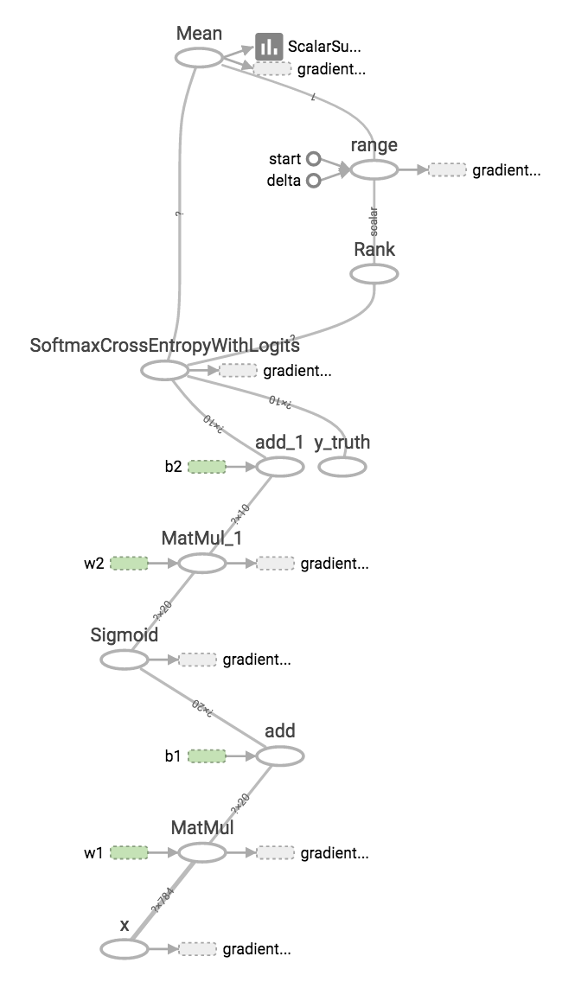
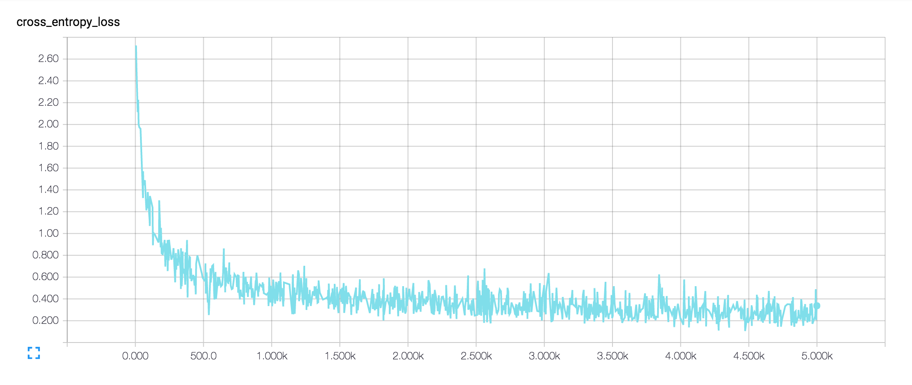
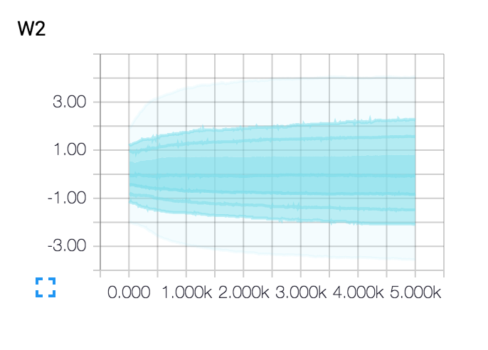
TensorBoard
$ tensorboard --logdir=summaries/
Starting TensorBoard on port 6006
(You can navigate to http://0.0.0.0:6006)

Slide 52
Fun Fact: Distributed Learning
GPU:0
GPU:1
Notes:
This is how tf distributes computation through multiple devices

Slide 53
Fun Fact: Distributed Learning
GPU
GPU
s
r
Notes:
It automatically adds sender and receiver nodes
that take care of data and gradient flow

Slide 54
TensorFlow
Define the computational graph first, then run data through it to train weights
Think about what’s going on under the hood if you run into issues
Use TF’s summary features to gain insight into your training

Slide 55
Part 5: Practical Advice

Slide 56
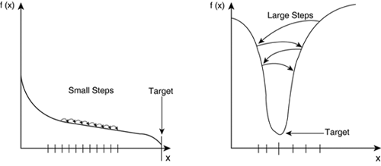
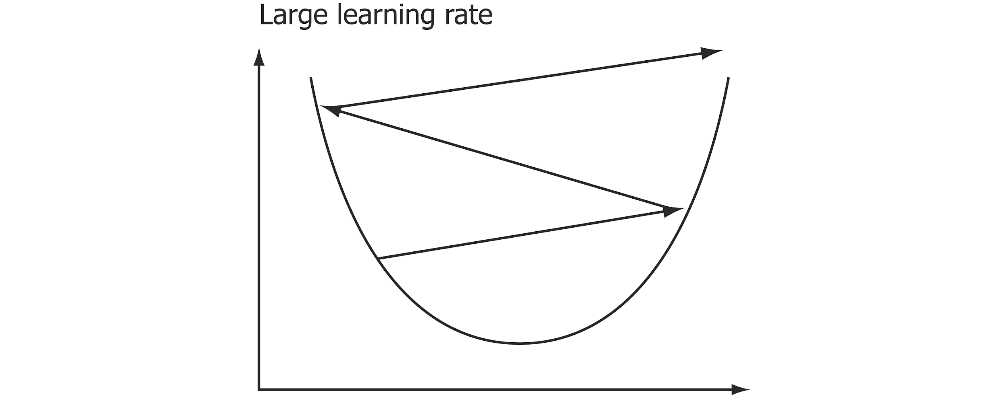
Careful with Learning Rates
Recall learning rate is what you multiply the gradient in the update step
Too small LR: converge too slowly
Too big LR: diverge
Learning Rates
loss
x1
Notes:
Learning rates are one of the many hyper parameters you can tune
Be careful with too big or too small learning rates

Slide 57
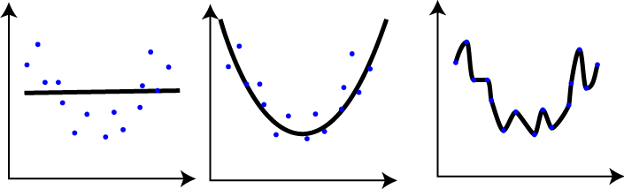
Underfitting Overfitting
Pretend your data lies in a multidimensional manifold
But it’s noisy!
Learning f is trying to approximate that manifold
So how do you know you’ve done it?
x2
x1
underfitting
just right
overfitting
Notes:
Data lies in manifold
But its noisy
Learning f == approximate manifold
Underfit and overfit
How do you know you’ve done it?

Slide 58
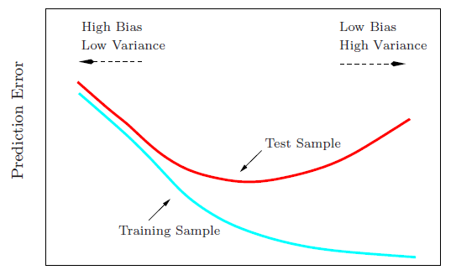
Test your model!
Once you trained your model, show it examples it has never seen before
The accuracy on those will show how well your model generalizes what it learned
So, before you begin training, separate your dataset into training and test sets
Training steps >

Slide 59

Get lots of data
Makes chance of overfitting smaller
If you can’t get lot’s of data, do fine tuning!
Blue & white dresses dataset
~400 examples
(not enough)

Slide 60
Fine Tuning
Pre-train on a larger dataset, then fine tune on the smaller
Idea is that many intermediate features you learn in the larger dataset are useful for the smaller too
Edges in images
imagenet
x
y
x
y
Blue & white dresses dataset

Slide 61
Practical Advice
Not learning well? Be careful with learning rates!
Divide your dataset into train and test set to see how well your NN generalizes
Get more data (!)
If you can’t get more data, fine tune

Slide 62


Thanks for coming!
Things I did not talk about:
tf.Queue
Convolutions - if your attributes are space-invariant
Recurrency - if your data has a time component
Always check the documentation! (or the source)
tensorflow.org github.com/tensorflow/tensorflow
Notes:
Things i didnt mention
How you can use queues to speed up loading data batches
How tf handles convolutions
How tf handles recurrent networks

Slide 63
Thanks for coming!
Things I did not talk about:
tf.Queue
Convolutions - if your attributes are space-invariant
Recurrency - if your data has a time component
Always check the documentation! (or the source)
tensorflow.org github.com/tensorflow/tensorflow
You, too, can contribute!
Notes:
Things i didnt mention
How you can use queues to speed up loading data batches
How tf handles convolutions
How tf handles recurrent networks

Slide 64

Wed Feb 15, 2017, MTV

Slide 65
TensorFlow Dev Summit Agenda
XLA: TensorFlow, Compiled! with Todd Wang and Chris Leary
TensorFlow High-Level API with Martin Wicke
Keras and TensorFlow with François Chollet
Distributed TensorFlow with Derek Murray
Creating Art & Music with Project Magenta with Doug Eck
TensorFlow Ecosystem: Hadoop and More with Jonathan Hseu
Serving Models in Production with TensorFlow Serving with Noah Fidel
Memorization + Generalization with TensorFlow Wide and Deep with Heng-Tze Cheng
Hands-on TensorBoard with Dandelion Mane
Mobile and Embedded TensorFlow with Pete Warden
ML Toolkit with Ashish Agarwal
Sequence Models and the RNN API with Eugene Brevdo
TensorFlow in Health with Lily Peng
videos

Slide 66


If you liked this stuff...
The Agency meets every Wednesday 6:30PM CCB 345
projects
machine learning talks
paper reading group
Big O meets every Monday 6:00PM ES&T L1175

Slide 67
Come back in 2 weeks!
TensorFlow
Workshop
Implement deep learning to detect Parkinson’s, choose robot actions, and generate Reddit Roasts
with Willie Agnew

